Slide 1
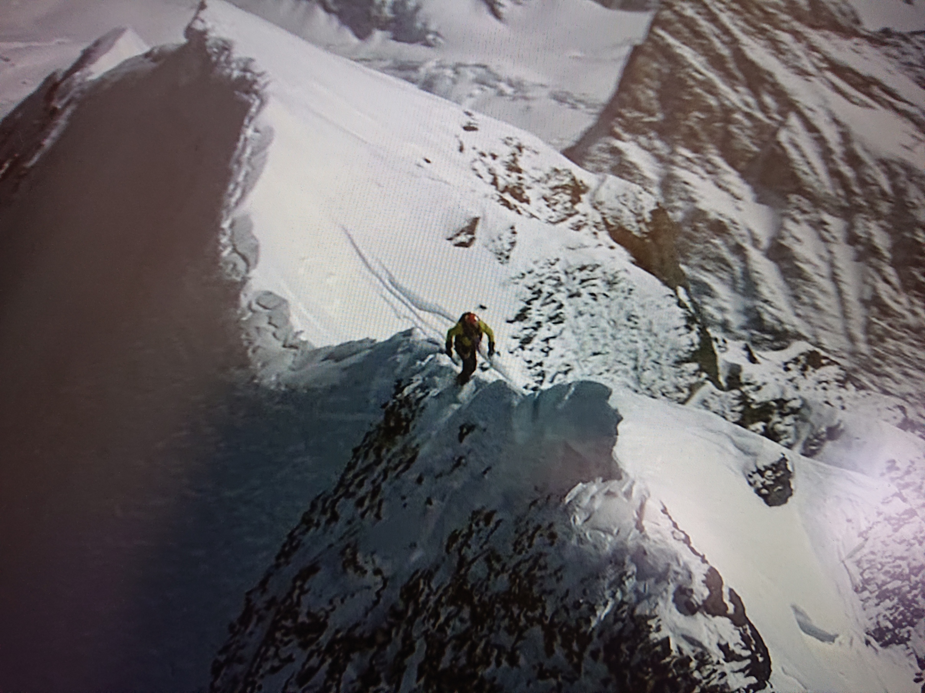
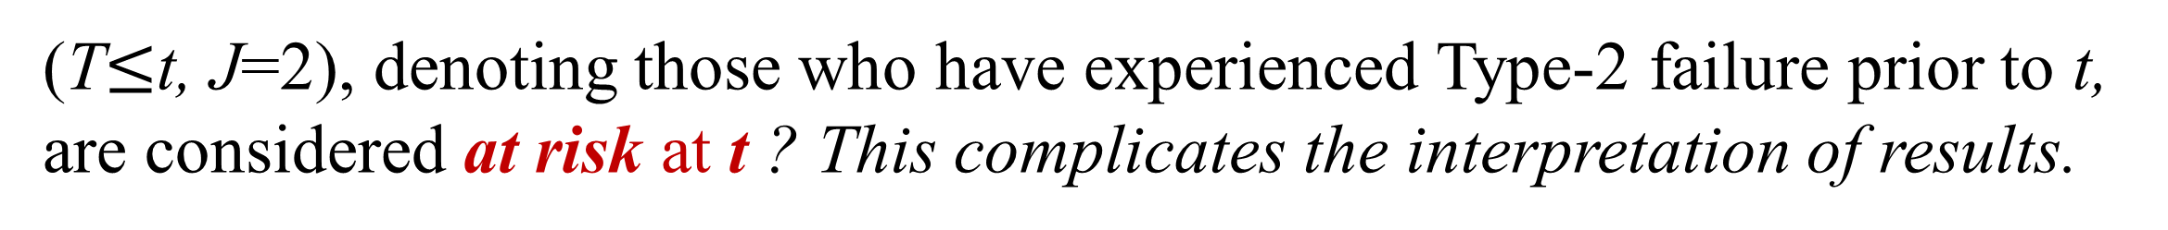
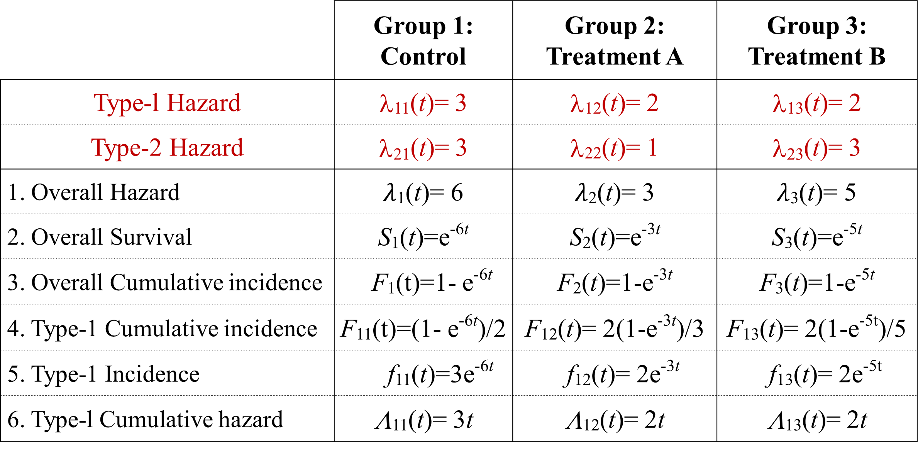
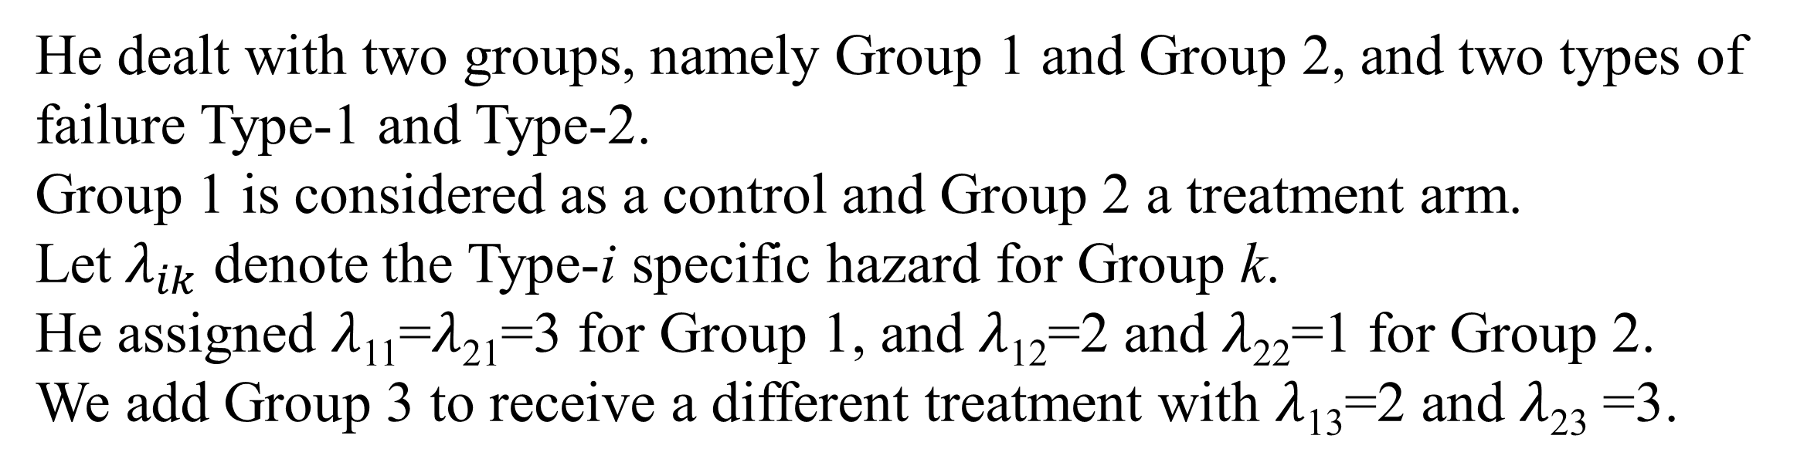
Cause-specific hazard or cause-specific incidence,
that is the question.
AASC2022
Left to Death, right to injure
Yamada T (Osaka Univ.), Nakamura T (Nagasaki Univ.), Mori H (Nagasaki Women’s College),
Saunders T (Nagasaki Univ.), Nose Y (Kyushu Univ.)
What’s wrong with the cumulative Incidence?
What’s wrong with the Fine-Gray hazard?
Gray (1988) shows a competing risk model where cumulative incidences can not be inferred from cause-specific hazards.
Fine-Gray hazard was developed for testing the covariate effect on the cause-specific cumulative incidence:
He dealt with two groups, namely Group 1 and Group 2, and two types of failure Type-1 and Type-2.
Group 1 is considered as a control and Group 2 a treatment arm.
Let$λ_{ik}$ denote the Type-i specific hazard for Group k.
He assigned $λ$₁₁=$λ$₂₁=3 for Group 1, and $λ$₁₂=2 and $λ$₂₂=1 for Group 2.
We add Group 3 to receive a different treatment with $λ$₁₃=2 and $λ$₂₃ =3.
$λ^{φ}\left(t\right)=$ $\lim_{Δ⟶0}{\frac{P\left\{\left(t≤T<t+Δ, J=1\right) | \left(t≤T\right)⋃\left(T≤t, J=2\right)\right\}}{Δ}}$
(T$≤$t, J=2), denoting those who have experienced Type-2 failure prior to t, are considered at risk at t ? This complicates the interpretation of results.
Besides, the hazard has serious problem as follows.
Statistics obtained from the hazards assumed for each group
Fine-Gray hazard depends on
independent censoring
 | Group 1: Control | Group 2: Treatment A | Group 3: Treatment B
Type-l Hazard | λ₁₁(t)= 3 | λ₁₂(t)= 2 | λ₁₃(t)= 2
Type-2 Hazard | λ₂₁(t)= 3 | λ₂₂(t)= 1 | λ₂₃(t)= 3
1. Overall Hazard | $λ$₁(t)= 6 | $λ$₂(t)= 3 | $λ$₃(t)= 5
2. Overall Survival | S₁(t)=e^{-6t} | S₂(t)=e^{-3t} | S₃(t)=e^{-5t}
3. Overall Cumulative incidence | F₁(t)=1- e^{-6t} | F₂(t)=1-e^{-3t} | F₃(t)=1-e^{-5t}
4. Type-1 Cumulative incidence | F₁₁(t)=(1- e^{-6t})/2 | F₁₂(t)= 2(1-e^{-3t})/3 | F₁₃(t)= 2(1-e^{-5t})/5
5. Type-1 Incidence | f₁₁(t)=3e^{-6t} | f₁₂(t)= 2e^{-3t} | f₁₃(t)= 2e^{-5t}
6. Type-l Cumulative hazard | Λ₁₁(t)= 3t | Λ₁₂(t)= 2t | Λ₁₃(t)= 2t
The most basic requirement for the hazard is that it should be independent of the distribution of independent censoring. However, the Fine-Gray hazard does depend on the distribution of independent censoring.
We have found a fatal gap in the mathematical proof to prove “the hazard is independent of independent censoring” in Fine and Gray (1999). Censoring was incorrectly modeled in the proof. The incorrect censoring model will be referred to as “Fine-Gary hazard in the Proof”, whilst correct censoring model as “Fine-Gray hazard as Defined” in the following simulation.
Numerical study to examine
dependency of censoring on Fine-Gray hazard
Fig.1:
Type-1 Cumulative incidence:
Fig.2:
Overall Survival curve
Failure times T₁, T₂ and censoring C are generated as follows: Let X, Y and Z denote (0,1)-uniform random variables.
Define T₁=80X+20Y and T₂=20X+80Y. Corr (T₁, T₂ )=0.5.
C is either 100Z or 20+60Z.
The latter is more centralized than the former.
crossing
Once T₁ and T₂ are generated, their values are fixed throughout each simulation; whilst, C is generated for each iteration.
λ₁₁ = 3 λ₂₁ = 3
λ₁₂ = 2 λ₂₂ = 1
λ₁₃ = 2 λ₃₂ = 3
Each iteration produces cumulative hazards Λ(t). Λ(t) under no censor is regarded as “true” and the others are estimates under censoring.
The average of Λ(t) over 1000 iterations is obtained for each simulation.
Since the cumulative incidences cross each other, despite their hazards are constant (Fig. 1), Gray noted that cumulative incidences can not be inferred from cause-specific hazards. This led him to develop the Fine-Gray hazard.
Cause specific hazard
Fine-Gray hazard: as Defined
Fine-Gray hazard: used in the Proof
The crossing curves come from an unrealistic assumption for the treatment effect.
First, Treatment A reduces Type-1 hazard by 1/3 (3 → 2) but Type-2 hazard by 2/3 (3 → 1). That is, the treatment is more effective against the competing cause than the cause of interest. This causes S₁(t)< S₂(t) (Fig. 2) and then leads to F₁₁(t) = ∫S₁(t)λ₁₁dt < ∫S₂(t)λ₁₂dt = F₁₂(t) for t >0.37 (Fig. 1) despite λ₁₁> λ₁₂.
“Fine-Gray hazard as defined” shows clear dependency on censoring,
but “Cause-specific hazard” and “Fine-Gray hazard in the Proof” show no dependency.
As for Group 3, Treatment B reduces Type-1 hazard by 1/3 (3 → 2) but does not reduce Type-2 hazard. In this case, F₁₁ is no longer crossing F₁₃ (Fig. 1).
Concluding remarks
Second, the higher overall survival rate (Fig. 2) shows a tremendous effect of Treatment A. Overall survival is the primary concern of patients.
Besides, in order to accurately estimate the disease-specific survival rate, it must be possible to determine the cause of death, but that is often quite difficult.
Cumulative incidence fails to present the treatment effect in Gray’s example. Whilst, cause-specific hazard presents the treatment effect properly.
Thus, cause-specific hazard is more preferable.
Fine-Gay hazard is mathematically not well defined.
It is left for future study to examine the performance of cumulative incidences under more realistic model and to find practical amendment to the Fine-Gray hazard.
Finally, unlike incidences, Type-1 hazard is not affected by Type-2 failure since Type-2 failure is independent of Type-1 failure, that is kind of censoring.
Conclusion:
Treatment effects can be properly inferred from the cause specific hazards but cannot by the cause-specific incidences in Gray’s example.
Literature
[1] Fine JP, Gray RJ. A proportional hazards model for the subdistribution of a competing risk.
J Am Stat Assoc 1999;94:496-509. 10.1080/01621459.1999.10474144
[2] Gray RJ. A class of K-sample tests for comparing the cumulative incidence of a competing risk.
Ann Stat 1988;16:1141-54. 10.1214/aos/1176350951
Australasian Applied Statistics Conference, 28 November - 2 December 2022, Victoria

